Slide 1
ADTs and Data Structure
Guda Pranay Netha
Credits: Prof Wortman, Kevin

Slide 2
What Is a Data Structure??
Data Structure: A data structure is a specific and organized arrangement of data elements that allows for efficient storage, retrieval, and manipulation of data. It defines the relationships and operations that can be performed on the data, providing a framework for representing and organizing information in a computer's memory.

Slide 3
ADT(Abstract Data Type)
An ADT is a high-level description of a set of operations on a data structure, abstracting away implementation details.
Defines logical properties and behaviors without specifying the internal representation.

Slide 4
Understand the Problem
Goals
Design data structures
Make them efficient
Analyze scientifically
Universal
Any CPU, OS, programming language, ...
Need to define a structure in an abstract way
Not code!

Slide 5
Abstract Data Type (ADT)
Abstract Data Type (ADT) defines a structure’s
Name
Description
Operations (functions)
Invariants (rules)
Operation is
A function with name, input arguments, output return type
Specification for what it does
Invariant is
Rule that structure must always obey
Internal organization
Operation may require or ensure a condition

Slide 6
Operation
An ADT operation is
A function with name, input arguments, output return type
Specification for what it does
Routine operations
Make (constructor)
Getters, setters (accessors, mutators)
Clear (make empty)
Iterator begin, end (loop through)
More interesting operations
Insert, Erase, Search, ...

Slide 7
Invariant
Invariant: a rule that a structure must always obey
For internal organization
Example: a unique pointer is either nullptr, or holds a valid dynamic object
Structure-wide invariants
Example: a sorted array must be in sorted order
Operation-specific invariant
Example: erase requires a non-empty list
Phrased as require or ensure
Operations must maintain invariants

Slide 8
PAIR DATA STRUCTURE

Slide 9
Pair Data Structure
Pair: data structure that holds two objects
first, second
may be different types
always two

Slide 10
Use Cases
Return two values pair<int, string> id_and_name(); pair<int, int> min_and_max(const vector<int>& v);
Map key-value pair
Note: T1 and T2 may be same or different

Slide 11
Pair<T1, T2> ADT
make-pair(T1 first, T2 second): Pair
Create a new pair containing first and second.
get-first(Pair p): T1
Return the first element of the pair.
get-second(Pair p): T2
Return the second element of the pair.
set-first(Pair p, T1 first)
Set the first element of the pair.
set-second(Pair p, T2 second)
Set the second element of the pair.

Slide 12
std::pair
C++ standard library implements the pair ADT in std::pair
Refer to https://www.cplusplus.com/reference/utility/pair/
constructor
data members first and second
Utility function make_pair

Slide 13
DYAD Data Structure

Slide 14
Dyad Data Structure
Dyad: data structure that holds
left object (or nothing)
right object (or nothing)
So 0-2 elements total
left, right
must be same type

Slide 15
Use Cases
Admittedly contrived
Thought exercise
Compare to pair
(soon) interesting iterator
Robot/character with two hands

Slide 16
Dyad<T> Operations
make-dyad(): Dyad
Create a new dyad that is empty (no left or right).
has-left(Dyad d): bool
Return true iff d has a left element.
has-right(Dyad d): bool
Return true iff d has a right element.
set-left(Dyad d, T left)
Set the left element of d to left.
set-right(Dyad d, T right)
Set the right element of d to right.
get-left(Dyad d): T
Return the left element.
Require: has-left(d) is true
get-right(Dyad d): T
Return the left element.
Require: has-left(d) is true
clear-left(Dyad d)
Make the left element of d empty.
clear-right(Dyad d)
Make the right element of d empty.
swap-left-right(Dyad d)
Swap the left and right elements.

Slide 17

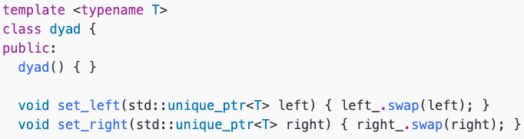
Implementation - Constructor, Setters
Default constructor is OK
Each pointer is nullptr = empty
Default destructor frees memory properly
unique_ptr::swap frees any old object, and takes ownership of the given object

Slide 18
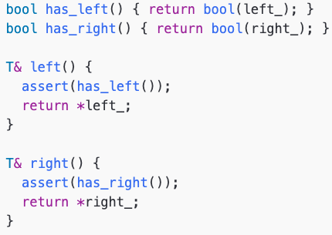
Implementation - Accessors
bool(left_) is true iff left_ is non-null
assert calls enforce ADT requirements

Slide 19
Sketching a Dyad
Dyad has
Left: pointer to an element, may be null
Right: (same)
Recall sketching a pointer
Arrow
Starts at pointer (inside Dyad object)
Ends at pointed-to object (left/right element)
Empty Dyad:
Dyad with left=9, right=2:
Dyad
left
right
nullptr
nullptr
Dyad
left
right
9
2

Slide 20
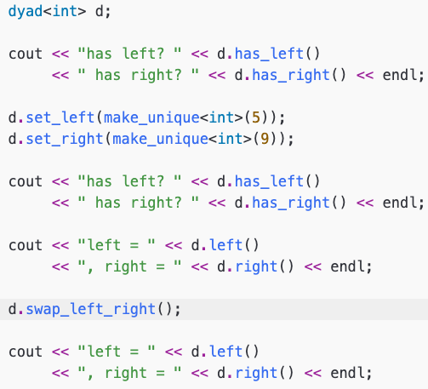

Example Usage

